Slide 1


Sales Analysis Dashboard
Presented by:
Sumidha Kumari Prasad

Slide 2
Problem Statement
Fluctuations in sales performance observed from 2003 to 2005, with a notable spike in November, potentially due to Black Friday.
Distribution analysis revealing that 61% of sales occur in the medium deal size category, indicating potential opportunities for optimization.
Strong demand for classic cars products suggests the need for further exploration and expansion of this product line.
The USA market demonstrates the highest sales volume, emphasizing the importance of strategic focus and potential for expansion into other regions.

Slide 3
Overview
Analyzed sales data from 2003 to 2005, focusing on key metrics such as total sales, average order value, and deal size distribution.
Identified trends and patterns in sales performance, including geographical variations and product line preferences.
Provided actionable insights and recommendations for optimizing sales strategies and improving overall performance.
Leveraged seasonal trends, optimized deal size distribution, expanded classic cars product line, strengthened USA market presence, and enhanced customer engagement.

Slide 4

KPIs
Total Sales: $10.03 million
Average Order Value: $3.55k
Average Price of Product: $84
Total Profit: $2M
Average Quantity Ordered: 35
Total SKUs: 7
Total Orders: 2823

Slide 5

Key Insights
There's a spike in sales in November, possibly due to Black Friday.
61% of sales happen in the medium deal size category.
Classic cars products have the highest sales.

Slide 6
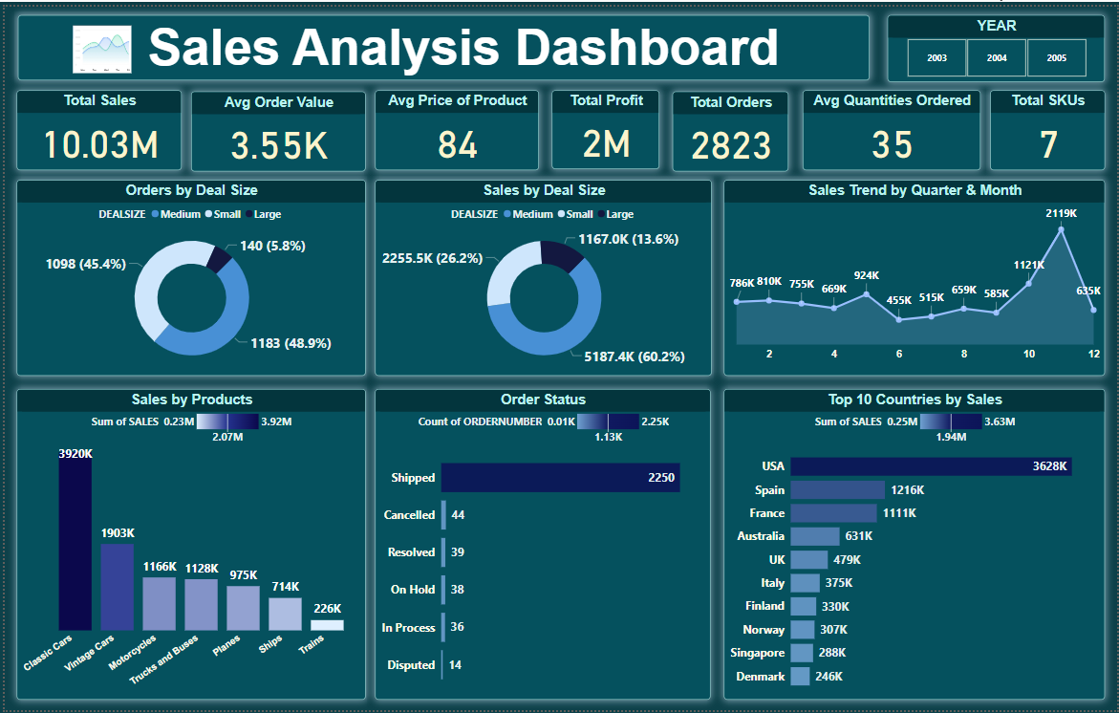
Consolidated Dashboard
Project Link
Comprehensive Sales Analysis

Slide 7
Recommendations
Part1
Leverage Seasonal Trends:
Capitalize on the observed spike in sales during November, likely due to Black Friday, by planning targeted promotions or campaigns around this period to drive sales.
Optimize Deal Size Distribution:
Focus on increasing sales in the medium deal size category, which accounts for 61% of sales, by offering bundled deals or promotions to encourage larger purchases.
Expand Classic Cars Product Line:
Given the popularity of classic cars products, consider expanding the product line or introducing related accessories to cater to the strong demand and potentially increase sales.

Slide 8
Recommendations
Part1
Strengthen USA Market Presence:
Continue to prioritize the USA market, which has the highest sales, and consider expanding into other regions with high sales potential based on the regional analysis.
Enhance Customer Engagement:
Implement strategies to enhance customer engagement and loyalty, such as personalized marketing campaigns, loyalty programs, or improved customer service, to drive repeat purchases and increase customer lifetime value.

Slide 9
Conclusion
Fluctuations in sales performance observed from 2003 to 2005, with a notable spike in November, potentially due to Black Friday.
Distribution analysis revealing that 61% of sales occur in the medium deal size category, indicating potential opportunities for optimization.
Strong demand for classic cars products suggests the need for further exploration and expansion of this product line.
The USA market demonstrates the highest sales volume, emphasizing the importance of strategic focus and potential for expansion into other regions.

Slide 10
Thank
You

